Slide 1
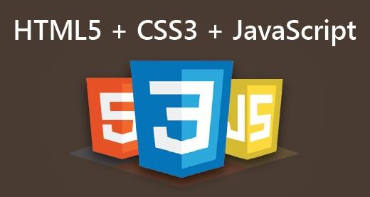
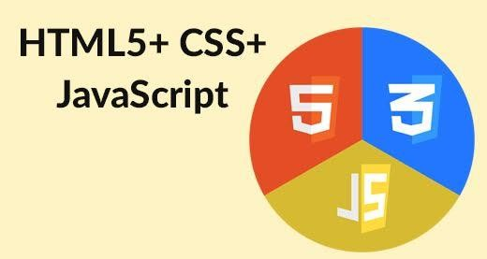

web development
With
HTML5, CSS3 and JavaScript

Slide 2

Objectives
At the end of this module, you will be able to:
→ Importance of Web Development
→ Front-end and Back-end Web Development
→ HTML, CSS and JavaScript - An Overview
→ JavaScript Frameworks - jQuery
→ Advanced Web Development Topics
pment

Slide 3
Importance of Web Development
The Internet is ubiquitous
Accessible through mobile and desktop
Customers/users need to find you/your business
Builds trust in your organization and improves your reputation
Your website is your first round-the-clock sales person!
The Website
Creates first impression of your business
Create it to suit the needs of your target audience
Reflects your expertise and reputation
Can bring business from any part of the world!
Call to Action – Encourage the users to give you business
You need Web Development skills to create a Website!

Slide 4
Things that can be done with Web Development.
Establishing payment gateways-(razorpay)
Providing UI to a database
We can use differentAPIs
http://www.csszengarden.com
https://getbootstrap.com/docs/4.3/getting-started/introduction/
https://unsplash.com/wallpapers/desktop
https://www.flipkart.com/
Enable chatting

Slide 5
Front End and Back End Web Development
Front End Web Development
Defined components on the page with HTML
Make them look pleasing with CSS
Enable interactivity with JavaScript
Enhance productivity with use of frameworks
Back End Web Development
Create the page components and content dynamically on the web server
Send the HTML + CSS + JavaScript to web browser (used by a human user)
Generate pages by programming in Java, JavaScript, PHP, Perl, Python, Ruby
Aim to achieve fast response times to end users
Front End Web Development is the focus of this webinar!

Slide 6
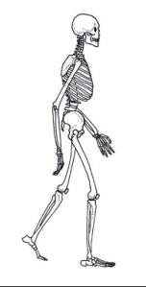


HTML, CSS, and JavaScript – An Overview
HTML
Hypertext Markup Language
Structure of Page
JavaScript
Interactivity with User
Dynamic Updates in a Web Page
CSS
Cascading Style Sheets
Presentation/Styling

Slide 7
A Simple HTML5 Page
Save the following code in a test.html file
<!DOCTYPE html>
<html>
<head>
<title>This is a Iosd Class</title>
</head>
<body>
<p>Welcome to HTML5, CSS3 and JavaScript!</p>
</body>
</html>

Slide 8
Hosting a Web Site
A Web Site
Serves one or more HTML Pages
Default Page: index.html, index.php
Served / Hosted by a Web Server
HTTP Web Server
httpd, apache2, Ngnix, inetmgr.exe - Internet Information Server (Microsoft’s)
Web Application Server
Apache Tomcat (Open Source), IBM WebSphere (Licensed)
Technologies
HTML, HTTP, TCP/IP Protocols
Operating Systems: Linux, Windows, MacOS

Slide 9
HTML Page
HTML (Web) Page / Document
User Interface for the Web (site or application)
A plain text file – human readable
Transported on HTTP - HyperText Transfer Protocol
Page Types
Static – ready-made pages with fixed page content
File Extension: .html, .htm
Dynamic – generated on the fly with varying page content
Generated on the Web Server
Interspersed with JavaScript, PHP, JSP, ASP
File Extensions: .js, .php, .jsp, .asp, .aspx

Slide 10

CSS - Introduction
Cascading Style Sheet
Describes the look and formatting of a page
Used for Changing Presentation and Styling
Can apply to a mark-up language
HTML, XHTML, XML, SVG
Separates Content from Presentation
Properties (Attributes) Styled
Layout, Font (Typography), Color, Background
Box Properties: Border, Margin, Padding
Lists, Tables

Slide 11
CSS Syntax (Contd./-)
Style Selector
The HTML elements to which the Style rule should be applied
It is a match expression
Specified as:
Element’s tag name
h1, p, label - case insensitive
Value of Element’s attribute
id, class - Case Sensitive
Element’s placement in the Document tree
Child element is nested within Parent
A Sibling element is at the same nesting level

Slide 12
CSS Syntax (Contd./-)
CSS Declaration Block
List of Declarations
Enclosed in curly braces { . . . }
Declaration
property : value(s) ;
property and value(s) are pre-defined
Property name is unique
Property value – Specified in multiple formats
keywords (words) or mnemonics (in combination with some symbols like: #, /)
numerical, hexadecimal, or a combination
some values may have units of measure

Slide 13

New CSS3 Selectors
New CSS3 Structural Pseudo-Class Selectors
E:first-of-type – Selects the first element of type E for its parent
li:first-of-type { color: red; }
E:last-of-type - Selects the last element of type E for its parent
li:last-of-type { color: yellow; }
E:only-child - Selects if E is only the child of its parent
li:only-child { color: blue; }
E:nth-child(n) - Selects nth child of the element E
li:nth-child(3) { color: yellow; }
E:nth-last-child(n) - Selects nth last child of the element E
li:nth-last-child(2) { color: red; }

Slide 14
CSS3 – 2D Transforms
Transformation
Change of position, shape and size of an element
CSS3 Transforms
2-D: Two Dimensions
3-D: Three Dimensions
Transform Operations
move, scale, spin, stretch and turn elements

Slide 15
CSS3 – 2D Transforms (Contd./-)
Specified with transform attribute
Translation – Movement along X-axis and Y-axis
transform: translate( 50px, 100px );
Rotation – in clock-wise direction
transform: rotate( 5deg );
Scaling – increase/decrease size along width and height
transform: scale( 2, 2 );
Skewing – tilting (turning) in X-axis and Y-axis directions
transform: skew( 10deg, 5deg);

Slide 16
CSS3 Transitions
Changing from one style to another (on an event)
CSS property on which the transition effect has to take place
Time Duration over which transition has to take place (smoothly)
Specified in seconds (s) or milliseconds (ms)
p { width: 100px; }
p:hover { width: 200px; transition: width 2s; }
Transition starts on events
Events: hover, active, checked, focus, enabled, disabled
@media queries, and JavaScript
Specify multiple transitions sets with a comma
p { width: 200px; height: 100px; }
p:hover {
width: 400px; height: 200px; transition: width 2s, height 5s; }

Slide 17
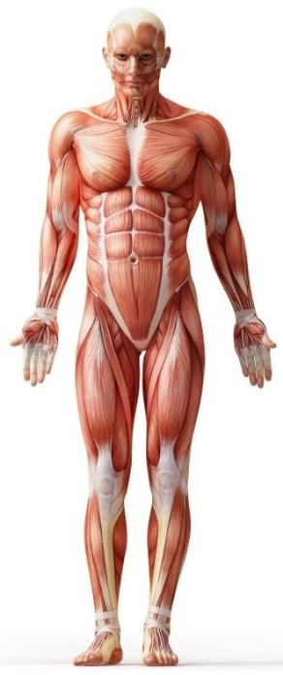
JavaScript – An Introduction
Mocha, later renamed as LiveScript - Developed by Netscape
Based on ECMAScript 5.1 (Ver. 6.0 is finalized in mid 2015)
LiveScript → JavaScript (due to Java popularity)
Scripting Language for Web Browsers
Dynamically Typed
Interpreted by JavaScript Engine
Can not Do (for Security Reasons)
Unlimited reading/writing of files from client machine’s file system
Writing to the files on the Server
Can not close a window that was not opened by it
Can not read from a web page served by another web server
Microsoft’s version - JScript

Slide 18
Document Object Model (DOM) (Contd./-)
Structure and Style of a Page, Access / Update Content
DOM + JavaScript = Dynamic HTML (on client-side)
What JavaScript can do with DOM?
Change an HTML Element
Change an attribute of an HTML Element
Change the CSS style of an HTML Element
Remove an existing HTML element or its attributes
Add new a HTML Element or a new attribute to an Element
React to an event associated with an HTML Element
Create a new event listener and associate with an HTML Element

Slide 19
HTML DOM Methods
DOM Methods – Finding HTML Elements
getElementById() Method
Gets the HTML Element with specified ID
getElementsByClassName() Method
Gets the HTML Elements with specified class name
document.getElementsByClassName("middlePara")[0].innerHTML = "Welcome to iosd!";
document.getElementsByClassName("middlePara")[1].innerHTML = "This is
HTML5, CSS3 and JavaScript Class!";
getElementsByTagName() method
Gets the HTML Elements with specified element tag
document.getElementsByTagName("p")[0].innerHTML = "Welcome to
iosd";
document.getElementsByTagName("p")[1].innerHTML = "This is HTML5, CSS3 and JavaScript Class!";

Slide 20
jQuery - Introduction
jQuery Core – a Cross-Platform JavaScript Library
Simplifies client-side JavaScript scripting for a web page
It is FREE and Open Source
Used by about 6,000 most visited websites
It uses the familiar HTML DOM model
Latest Versions
Version 1.11.3 - has support for IE 6/7/8
Version 2.1.4 - has NO support for IE 6/7/8
Development Version
For use during development of the website
Minified Version
For use in production (live / online) use of website

Slide 21
jQuery - Introduction
Why use jQuery?
JavaScript Framework
Separates HTML and JavaScript in a web page
Eliminates cross-browser incompatibilities
Simple/Short, Clean and Easy to read, write and understand
What jQuery can do?
Can Select Elements
Has Selectors are similar to CSS Selectors
Can Manipulate the Selected Elements
Can Modify the Style of the Selected Elements
Supports Events, Effects and Animations
Supports JSON Parsing and Ajax (Asynchronous JavaScript + XML)

Slide 22

jQuery Basics
Download the latest version
From jquery.com website
Reference it in HTML file
Host it on your Web Server and Use it with <script> tag
<script src="jquery-2.1.3.js"></script>
Point to a Public Web Server and Use it with <script> tag
Google CDN Server (recommended)
CDN – Content Delivery Network
<script src="http://ajax.googleapis.com/ajax/libs/jquery/2.1.3/jquery.min.js">
</script>
Microsoft CDN Server
<script src="http://ajax.aspnetcdn.com/ajax/jQuery/jquery-1.11.2.min.js">
</script>
MaxCDN CDN Server (moved from MediaTemple, before that Amazon)
<script src="http://code.jquery.com/jquery-2.1.3.min.js"></script>
Do not put the jQuery code in the <script> tag that loads jQuery library

Slide 23
Thank You

